Slide 1
BMI508 – Fall 2026
Introduction to Biomedical Ontology
Class 2 – Sept 2, 2026
What is an ontology?
Werner CEUSTERS
Department of Biomedical Informatics, University at Buffalo, USA

Slide 2
Assignment A1
A1: Reading R1 contains on the pages 17 to 19 several literal examples of what went wrong in certain representational systems and explains why they are mistakes. Of these examples, pick three mistakes, each one being of a distinct type, and do for each of these examples the following:
    (1) copy the example to a Word document,
    (2) explain in 1 sentence what the type of mistake is,
    (3) find a similar mistake in one of the representational systems of which the links are provided in class C1, but not a mistake that has been discussed in class C1 or C2.
    (4) use what you learned from R2 and the C1 and C2 lectures to propose a correction and motivate why it is correct.
Upload your work in a Word doc to the assignment folder. Name of the file: ‘BMI508-A1-[your ubitname].docx’
Due date: Sep 7 – noon.

Slide 3
Assessment of A1
Three concrete and distinct examples identified: 20%
Mistakes correctly explained: 20%
Similar mistakes found in the representational systems discussed in C1 and explained why: 40%
Soundness of proposed corrections with argumentation and motivation from R2 and lecture carried out: 20%.
Counts for 3% of total final score.

Slide 4
‘Ontology’
In philosophy:
  Ontology (no plural) is the study of what entities exist and how they relate to each other;

Slide 5
‘Ontology’
In philosophy:
  Ontology (no plural) is the study of what entities exist and how they relate to each other;
  by some philosophers taken to be synonymous with ‘metaphysics’ while others draw distinctions in many distinct ways (the distinctions being irrelevant for this talk), but almost agreeing on the following classification:
    metaphysics → studies ‘how is the world?’
      general metaphysics → studies general principles and ‘laws’ about the world
        ontology → studies what type of entities exist in the world
      special metaphysics → focuses on specific principles and entities
  distinct from ‘epistemology’ which is the study of how we can come to know about what exists.
  distinct from ‘terminology’ which is the study of what terms mean and how to name things.

Slide 6
Distinct questions of distinct types
Terminological:
  what does ‘pain’ mean ?
Metaphysical:
  what have all pains in common in virtue of which they are pains?
Ontological:
  what type of entity is pain?
Onto-terminological:
  what, if anything at all, does ‘pain’ denote?
Epistemological:
  how can we find out whether something is pain?

Slide 7
The Terminology / Ontology divide
Terminology:
  solves certain issues related to language use, i.e. with respect to how we talk about entities in reality (if any);
    Relations between terms / ‘concepts’
  does not provide an adequate means to represent independent of use what we talk about, i.e. how reality is structured;
    Women, Fire and Dangerous Things (Lakoff).

Slide 8
The Terminology / Ontology divide (2)
Terminology:
  solves certain issues related to language use, i.e. with respect to how we talk about entities in reality (if any);
    Relations between terms / ‘concepts’
  does not provide an adequate means to represent independent of use what we talk about, i.e. how reality is structured;
    Women, Fire and Dangerous Things (Lakoff).
Ontology (of the right sort):
  Language and perception neutral view on reality.
    Relations between entities in first-order reality

Slide 9
What you should NEVER FORGET !!!
(major take home message)
Crucial distinctions made in Ontological Realism
‘ontology’ ←→ ‘ontologies’

Slide 10
‘ontology’ denotes ambiguously
In philosophy:
  Ontology (no plural) is the study of what entities exist and how they relate to each other;
In computer science and many biomedical informatics applications:
  An ontology (plural: ontologies) is a shared and agreed upon conceptualization of a domain.
T. R. Gruber. A Translation Approach to Portable Ontology Specifications. Knowledge Acquisition, 5(2):199–220, 1993.

Slide 11
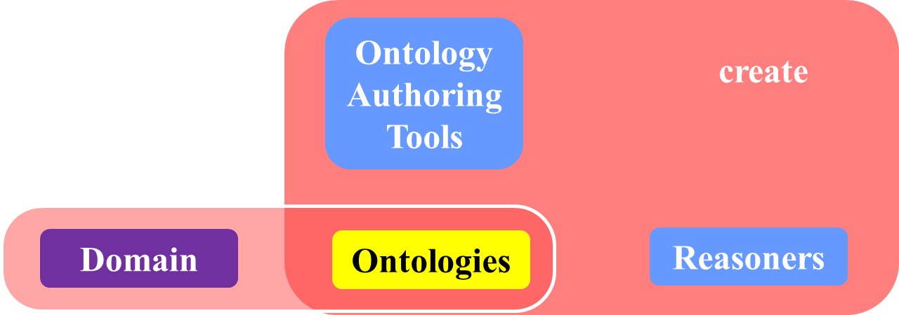
Computer science approach to ontology (1)
Reasoners are parts of ontology authoring tools to facilitate the creation of ontologies designed for some domain of discourse.

Slide 12
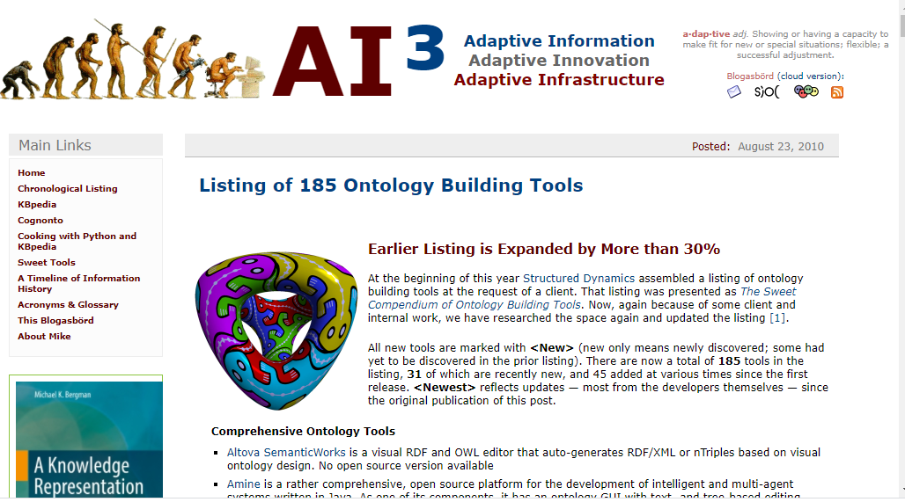
Ontology authoring tools (in 2010)

Slide 13

Most popular (and abused) OAT: Protégé

Slide 14
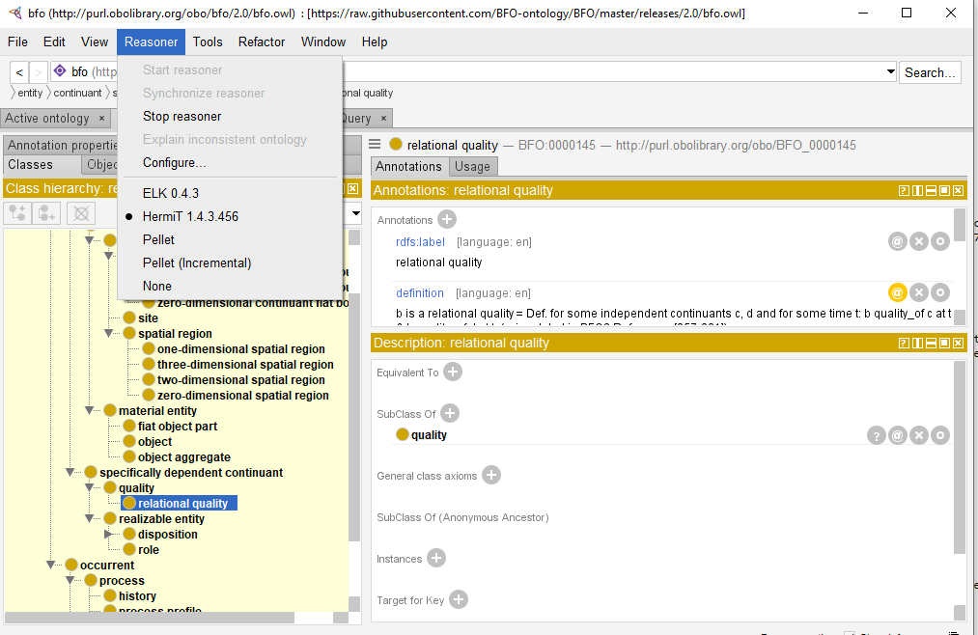
Reasoners in Protégé

Slide 15
Remarks on SNOMED CT-reasoner (1)
Often the reasoner gives correct results:
  Click for good classification example

Slide 16
Remarks on SNOMED CT-reasoner (2)
Often the reasoner gives correct results:
  Click for good classification example
Sometimes the reasoner gives debatable results:
  Click for dubious classification example

Slide 17
Remarks on SNOMED CT-reasoner (3)
Often the reasoner gives correct results:
  Click for good classification example
Sometimes the reasoner gives debatable results:
  Click for dubious classification example
The reasoner ALWAYS uses the same algorithm, but the definitions it reasons with are sometimes debatable, if not totally wrong!

Slide 18
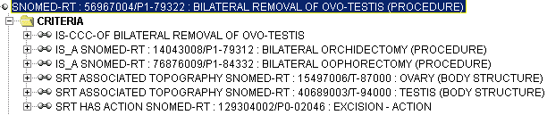
Consistent reasoning with nonsensical representations
Ceusters W, Smith B, Flanagan J. Ontology and Medical Terminology: why Descriptions Logics are not enough. Proceedings of the conference Towards an Electronic Patient Record (TEPR 2003),
San Antonio, 10-14 May 2003 (electronic publication 5pp)

Slide 19
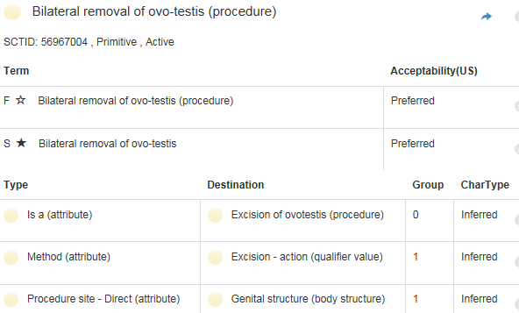
Correction
http://browser.ihtsdotools.org/
Oct 14, 2015

Slide 20
Remarks on SNOMED CT-reasoner (4)
Often the reasoner gives correct results:
  Click for good classification example
Sometimes the reasoner gives debatable results:
  Click for dubious classification example
The reasoner ALWAYS uses the same algorithm, but the definitions it reasons with are sometimes debatable, if not totally wrong!
See also: Stefan Schulz
  SNOMED CT’s Ontological Commitment
  International Conference on Biomedical Ontology
  University at Buffalo, NY · July 24-26, 2009

Slide 21
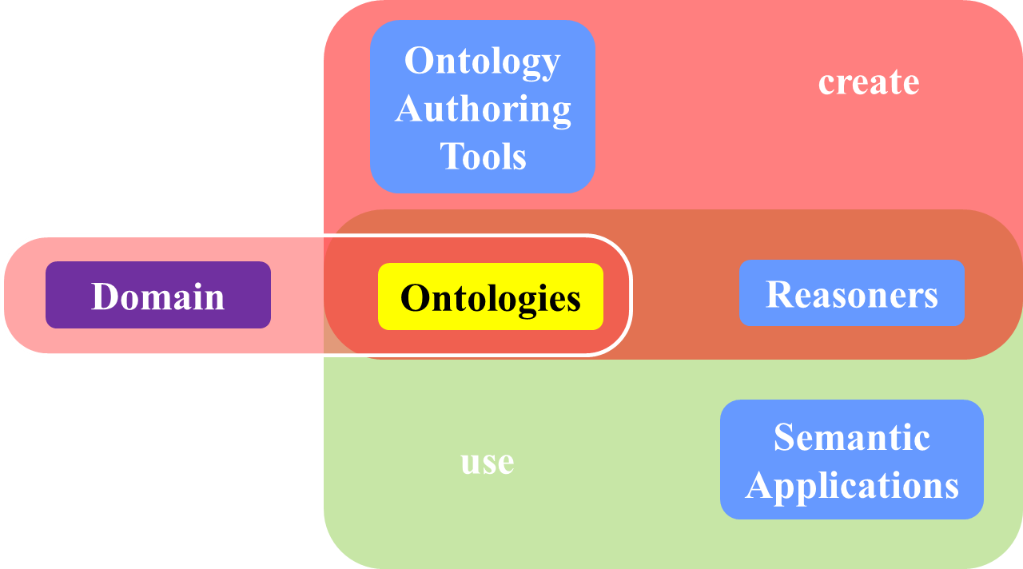
Computer science approach to ontology (2)

Slide 22
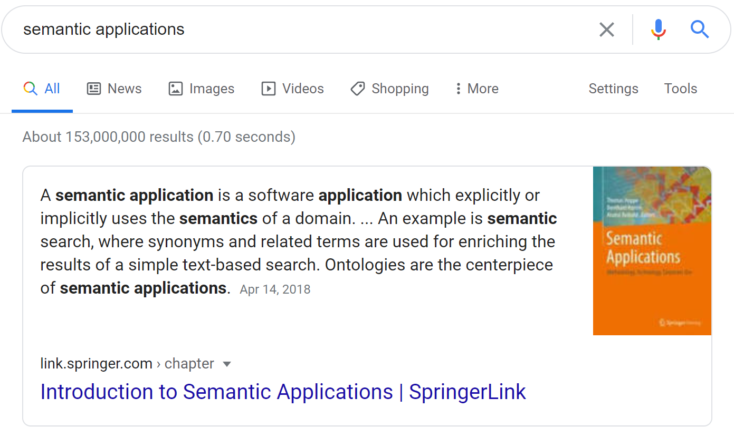
Semantic applications
A semantic application is a software application which explicitly or implicitly uses the semantics of a domain. An example is semantic search, where synonyms and related terms are used for enriching the results of a simple text-based search. Ontologies are the centerpiece of semantic applications. Apr 14, 2018

Slide 23
Semantic search examples
‘Black cowboy boots’
‘Werner Ceusters’

Slide 24
Computer science approach to ontology (1*)
Reasoners are parts of ontology authoring tools to facilitate the creation of ontologies designed for some domain of discourse.

Slide 25
Computer science approach to ontology (3)

Slide 26
Computer science approach to ontology (4)
the logic in reasoners:
guarantees consistent reasoning,
does not guarantee the faithfulness of the representation.

Slide 27
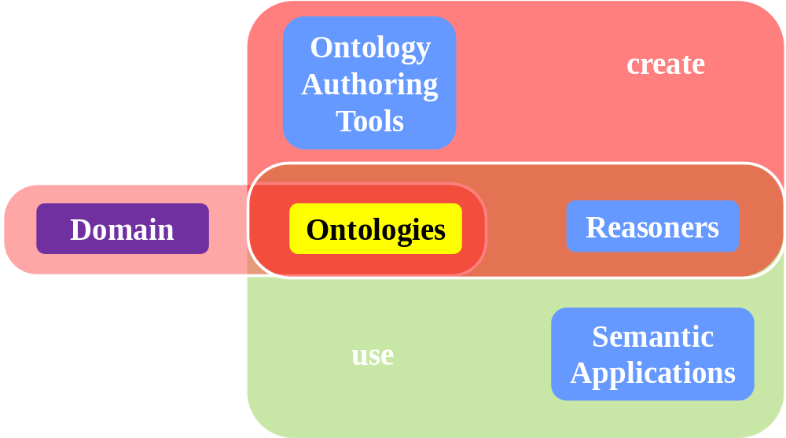

Specific philosophical approach to ontology
Ontological Realism (ORe): uses ontology as philosophical discipline to build ontologies as faithful representations of reality.
Notes:
Difference between ‘domain’ as short for ‘domain of discourse’ and ‘domain’ as a portion of reality.

Slide 28
The ORe definition for ‘an ontology’
‘a representational artifact, comprising a taxonomy as proper part, whose representational units are intended to designate some combination of universals, defined classes, and certain relations between them’
Smith B, Kusnierczyk W, Schober D, Ceusters W.
Towards a Reference Terminology for Ontology Research and Development in the Biomedical Domain.
Proceedings of KR-MED 2006, Biomedical Ontology in Action,
November 8, 2006, Baltimore MD, USA.
http://ontology.buffalo.edu/bfo/Terminology_for_Ontologies.pdf

Slide 29
The ORe definition of ‘a taxonomy’
a tree-form graph-theoretic
representational artifact with nodes representing
universals or classes and edges representing is_a or (‘or’ here =aka!) subset relations.
Smith B, Kusnierczyk W, Schober D, Ceusters W.
Towards a Reference Terminology for Ontology Research and Development in the Biomedical Domain.
Proceedings of KR-MED 2006, Biomedical Ontology in Action,
November 8, 2006, Baltimore MD, USA.
http://ontology.buffalo.edu/bfo/Terminology_for_Ontologies.pdf
a hierarchy consisting of terms denoting types (or
universals) or classes linked by subtype relations.
Arp, R., B. Smith, and A.D. Spear,
Building ontologies with basic formal ontology. 2015,
The MIT Press,: Cambridge, Massachusetts. p. 1 online resource (245 p).

Slide 30
Graph Data Structure And Algorithms
A Graph is a non-linear data structure consisting of nodes and edges. The nodes are sometimes also referred to as vertices and the edges are lines or arcs that connect any two nodes in the graph.
More formally a Graph can be defined as: a finite set of vertices(or nodes) and set of Edges which connect a pair of nodes.
Graphs are used to solve many real-life problems. Graphs are used to represent networks. The networks may include paths in a city or telephone network or circuit network. Graphs are also used in social networks like linkedIn, Facebook. For example, in Facebook, each person is represented with a vertex(or node). Each node is a structure and contains information like person id, name, gender, locale etc.
Topics:
Introduction, DFS and BFS
Graph Cycle
Topological Sorting
Minimum Spanning Tree
BackTracking
Shortest Paths
Connectivity
Maximum Flow
STL Implementation of Algorithms
Hard Problems
Misc
Quick Links
For more info, consult this link.

Slide 31
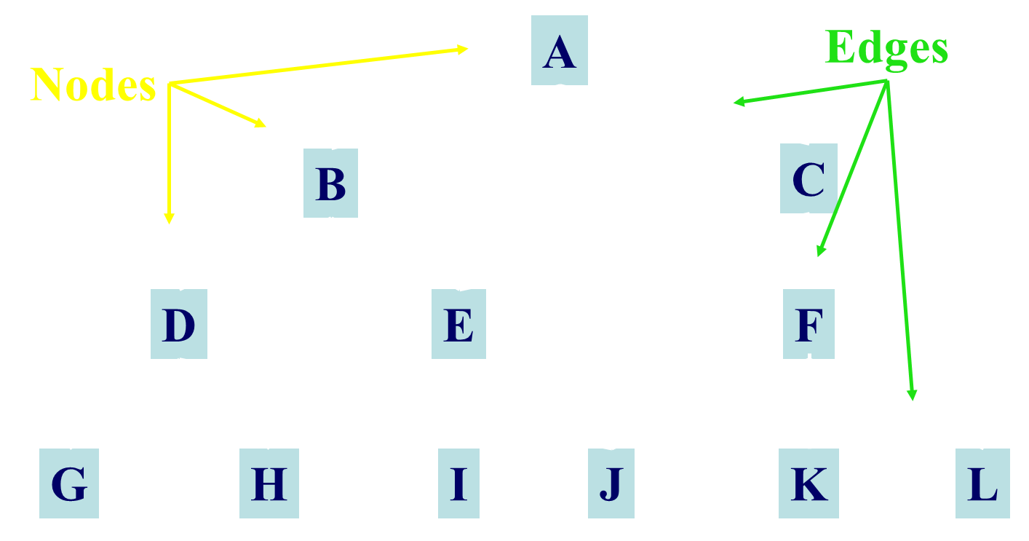
Graph theoretical structure

Slide 32
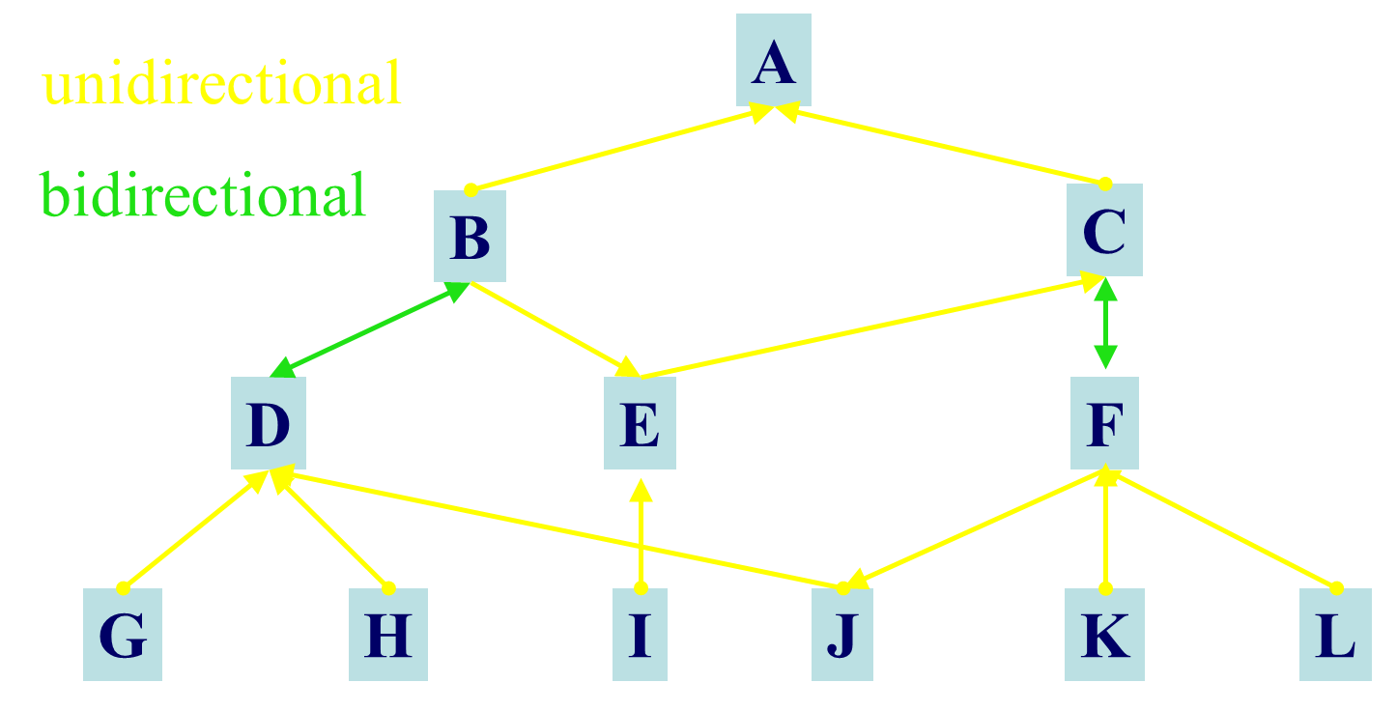
Directed Graph: edges are arrows

Slide 33
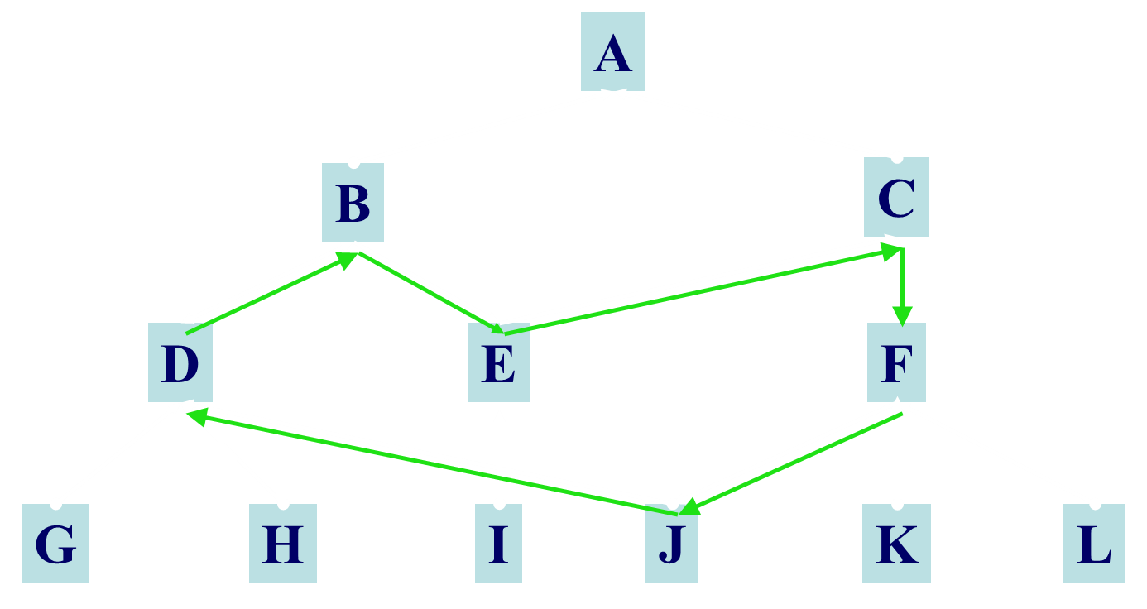
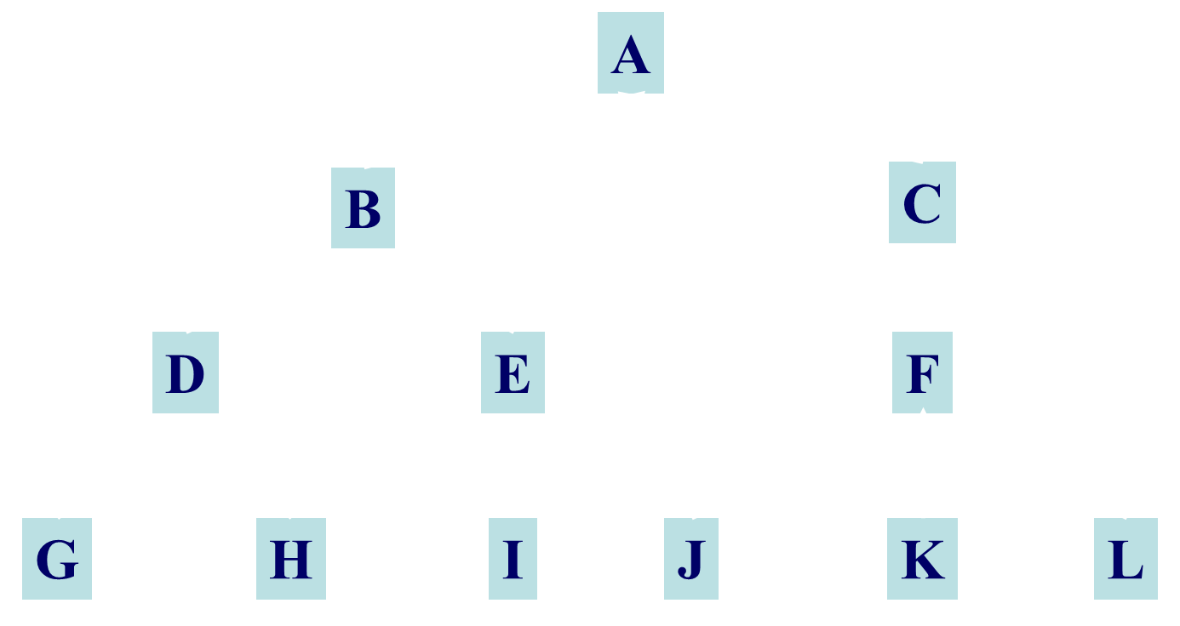
Directed Cyclic Graph

Slide 34
Graph theoretical structure: tree
No circles, one outgoing arrow per node

Slide 35
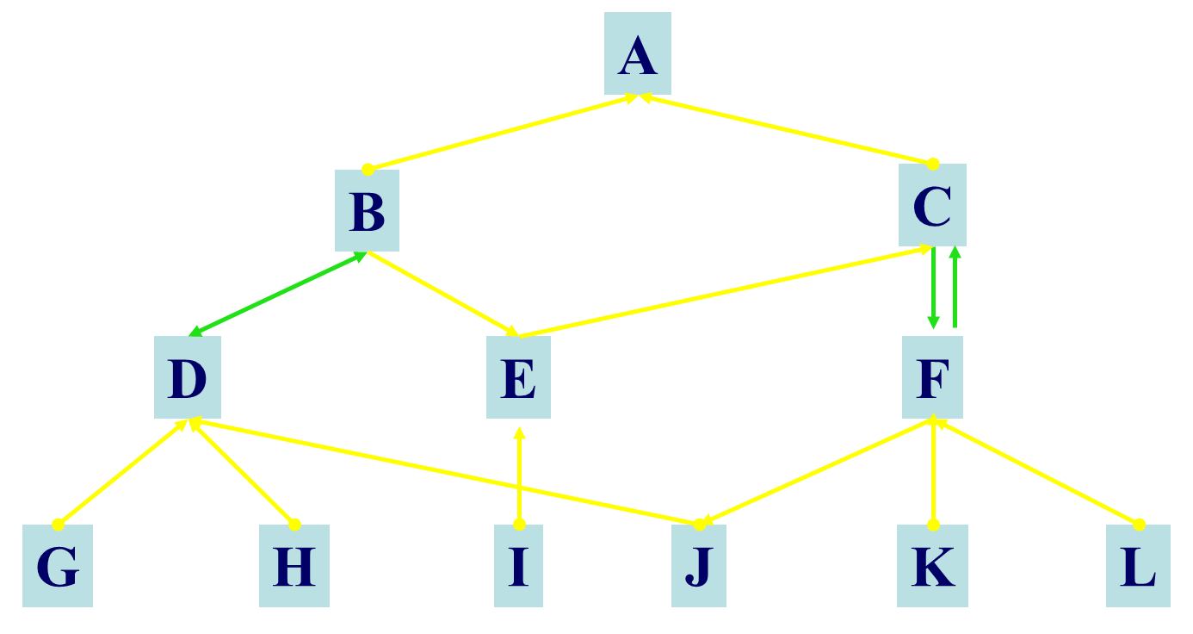
Labelled graphs → ‘semantic networks’

Slide 36
Labelled graphs
Decisions on what nodes and arrows represent.
Restrictions on:
  what labelled arrows can appear between labelled nodes;
  whether sequences of labelled arrows form a labelled arrow in their own right.
Very weak semantics, if any at all!

Slide 37
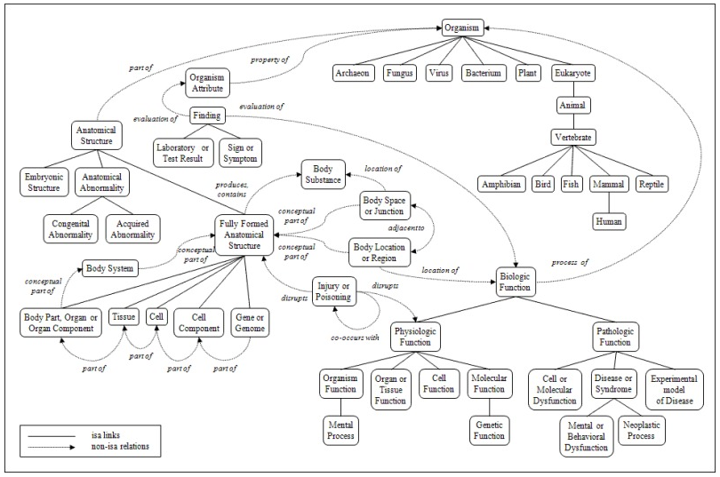
UMLS Semantic Network ™
UMLS Semantic Network

Slide 38
Some graph structure
Mary
parent
mother
mother
John
son
son
John

Slide 39
Same graph structure
Four distinct representations
Mary
parent
mother
mother
child of
child of
child of
son of
John
son
son
John

Slide 40
Same graph structure
Four distinct representations
Mary
parent
mother
mother
child of
child of
child of
son of
John
son
son
John
Generic versus specific terms.
Implicit relationships between what nodes and vertices represent and between vertices.

Slide 41
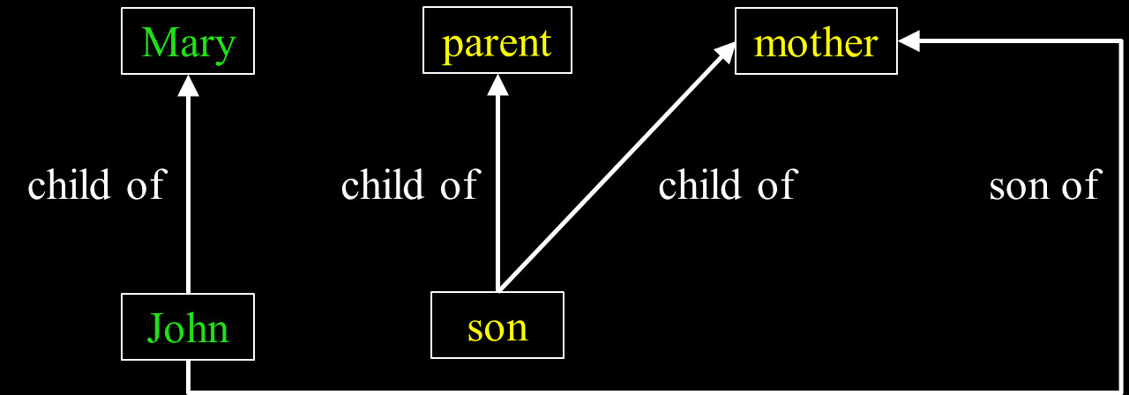
The four graphs in one semantic network (1)

Slide 42
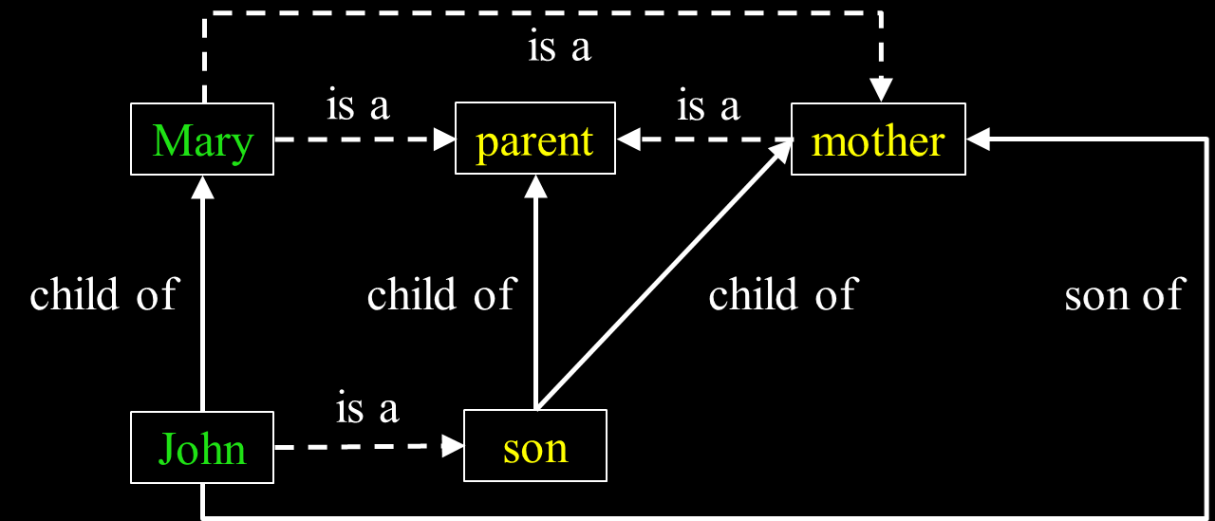
The four graphs in one semantic network (2)
Do the 4 isa-links represent the same relation?

Slide 43
The four graphs in one semantic network (3)
is a?
Would the ‘is a’ hold between ‘son of’ and ‘child of’?

Slide 44
Distinct structures
Similar representations
Object
Attribute - triples
Value
Mary
parent
child
John
son
mother

Slide 45
Distinct structures
Similar representations
Object
Attribute - triples
Value
Mary
parent
child
John
son
mother
V
A
O
Mary
child of
John

Slide 46
Distinct structures
Similar representations
Object
Attribute - triples
Value
Mary
parent
child
John
son
mother
V
A
O
V
A
O
Mary
parent
child of
child of
John
son

Slide 47
Distinct structures
Similar representations
Object
Attribute - triples
Value
Mary
parent
child
John
son
mother
A
O
V
V
A
O
V
A
O
Mary
parent
mother
child of
child of
child of
John
son
son

Slide 48
Distinct structures
Similar representations
Object
Attribute - triples
Value
Mary
parent
child
John
son
mother
A
O
V
V
A
O
A
V
A
O
O
V
Mary
parent
mother
mother
child of
child of
child of
son of
John
son
son
John

Slide 49
Some foundational papers
Woods, W.A., What's in a link? foundations for semantic netowrks. 1975, Cambridge, Mass.?: Bolt, Beranek and Newman. 70 p.
Brachman, R.J., What's in a concept? structural foundations for semantic networks. 1976, Cambridge, Mass.?: Bolt, Beranek and Newman. 41 p.
Many ‘what’s in a …’ papers later, but none of them ‘foundational’ to the same extent.
Bottom line: much more organization is needed !!!

Slide 50
The main features provided by ontologies in support of biological and biomedical research
Ontology feature | Utility in research
Classes and relations | The use of standard identifiers for classes and relations in ontologies is what enables data integration across multiple databases because the same identifiers can be used across multiple, disconnected databases, files, or web sites.
Domain vocabulary | Through labels associated with classes and relations, ontologies provide a domain vocabulary that can be exploited for applications ranging from natural language processing, creation of user interfaces, etc.
Metadata and descriptions | Textual definitions, descriptions, examples and further metadata associated with classes in ontologies are what enable domain experts to understand the precise meaning of class in the ontology. The definitions and related metadata should allow consistent understanding of the meaning of classes in ontologies.
Axioms and formal definitions | Formal definitions and axioms enable automated and computational access to (some parts of) the meaning of a class or relation.
Table 1 from: The role of ontologies in biological and biomedical research: a functional perspective.
R Hoehndorf, PN Schofield, GV Gkoutos
Briefings in bioinformatics 16 (6), 1069-1080

Slide 51
The ORe definition for ‘an ontology’
‘a representational artifact, comprising a taxonomy as proper part, whose representational units are intended to designate some combination of universals, defined classes, and certain relations between them’
Smith B, Kusnierczyk W, Schober D, Ceusters W.
Towards a Reference Terminology for Ontology Research and Development in the Biomedical Domain.
Proceedings of KR-MED 2006, Biomedical Ontology in Action,
November 8, 2006, Baltimore MD, USA.
http://ontology.buffalo.edu/bfo/Terminology_for_Ontologies.pdf

Slide 52
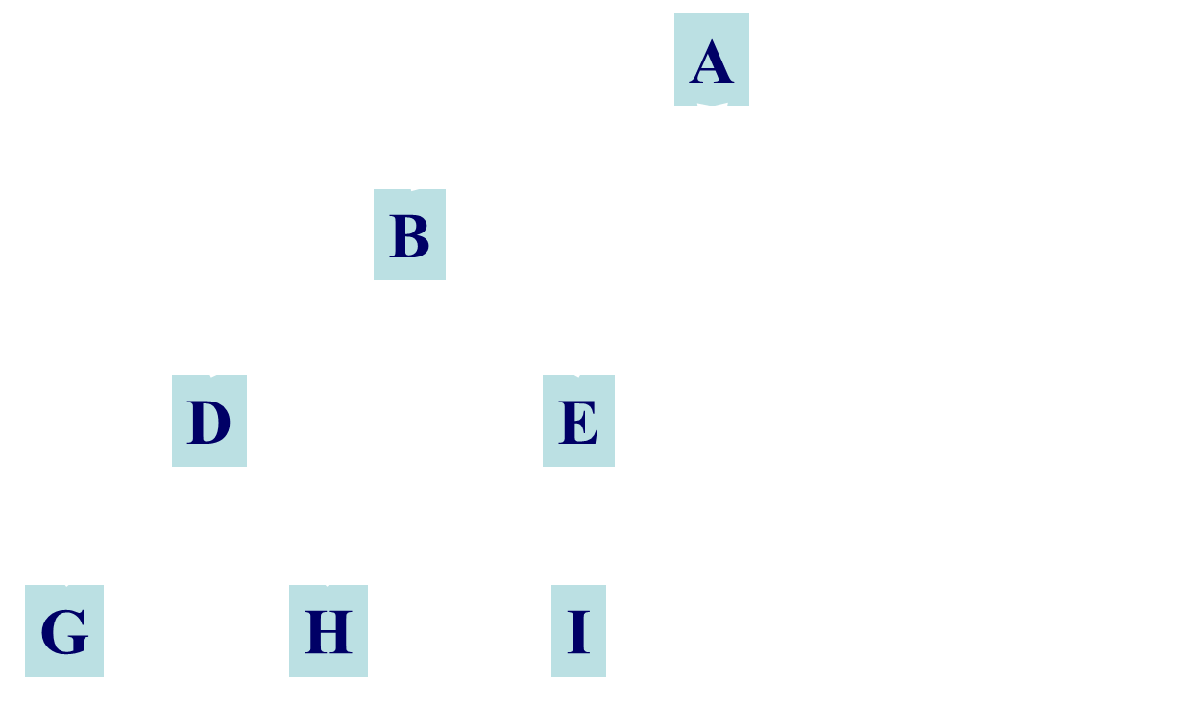
Taxonomic tree
All nodes represent groups (X, Y, …) the members of which have something (S_{x}, S_{y, …}) similar in some way.
All edges represent the same relation r which expresses some classificatory principle which is such that if X r Y holds, then the members of X have similarities S_{x} and S_{y}.

Slide 53
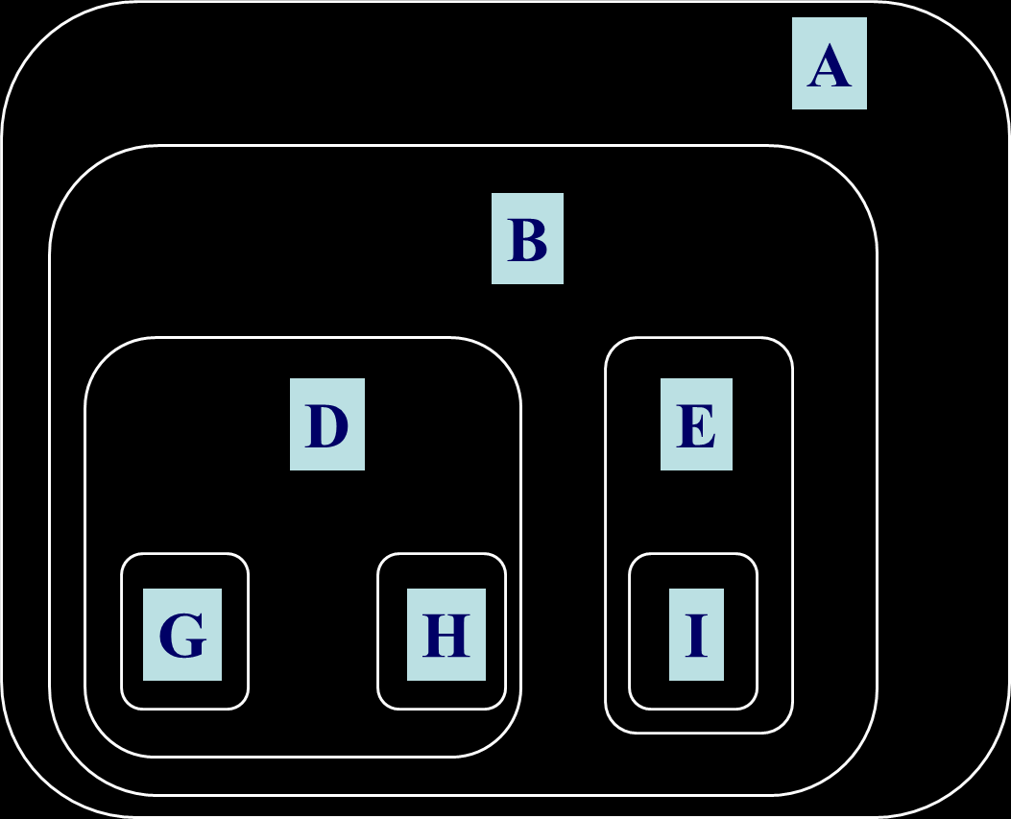
Taxonomic tree as sets

Slide 54
Is this graph a tree?
Is this representation a taxonomy?
Cardiovascular System [A07]
  Blood Vessels [A07.015]
  Blood-Air Barrier [A07.020]
  Blood-Aqueous Barrier [A07.030]
  Blood-Brain Barrier [A07.035]
  Blood-Nerve Barrier [A07.037]
  Blood-Retinal Barrier [A07.040]
  Blood-Spinal Cord Barrier [A07.043]
  Blood-Testis Barrier [A07.045]
  Glomerular Filtration Barrier [A07.500]
  Glymphatic System [A07.521]
  Heart [A07.541]
    Endocardium [A07.541.207]
    Fetal Heart [A07.541.278]
    Heart Atria [A07.541.358]
    Heart Conduction System [A07.541.409]
    Heart Septum [A07.541.459]
      Atrial Septum [A07.541.459.249]
      Endocardial Cushions [A07.541.459.374]
      Foramen Ovale [A07.541.459.500]
      Ventricular Septum [A07.541.459.750]
    Heart Valves [A07.541.510]
    Heart Ventricles [A07.541.560]
    Myocardium [A07.541.704]
    Pericardium [A07.541.795]
Cardiovascular System [A07]
  Blood Vessels [A07.015]
  Blood-Air Barrier [A07.020]
  Blood-Aqueous Barrier [A07.030]
  Blood-Brain Barrier [A07.035]
  Blood-Nerve Barrier [A07.037]
  Blood-Retinal Barrier [A07.040]
  Blood-Spinal Cord Barrier [A07.043]
  Blood-Testis Barrier [A07.045]
  Glomerular Filtration Barrier [A07.500]
  Glymphatic System [A07.521]
  Heart [A07.541]
    Endocardium [A07.541.207]
    Fetal Heart [A07.541.278]
    Heart Atria [A07.541.358]
    Heart Conduction System [A07.541.409]
    Heart Septum [A07.541.459]
      Atrial Septum [A07.541.459.249]
      Endocardial Cushions [A07.541.459.374]
      Foramen Ovale [A07.541.459.500]
      Ventricular Septum [A07.541.459.750]
    Heart Valves [A07.541.510]
    Heart Ventricles [A07.541.560]
    Myocardium [A07.541.704]
    Pericardium [A07.541.795]

Slide 55
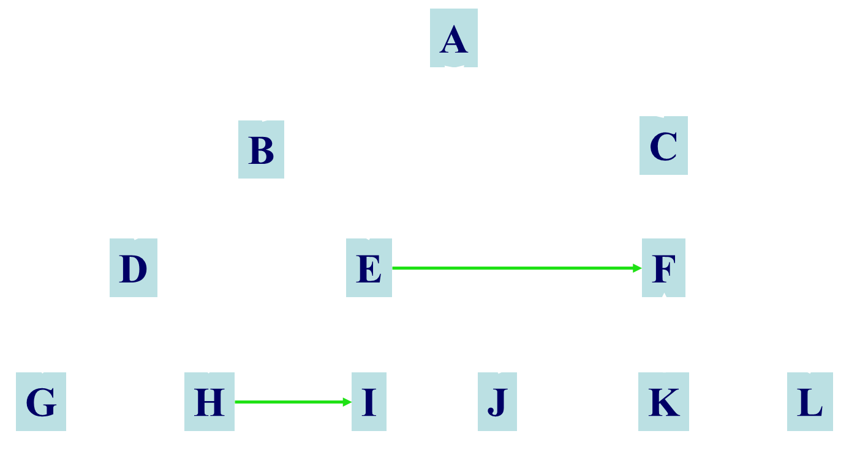
Taxonomic tree with non-taxonomic relations

Slide 56
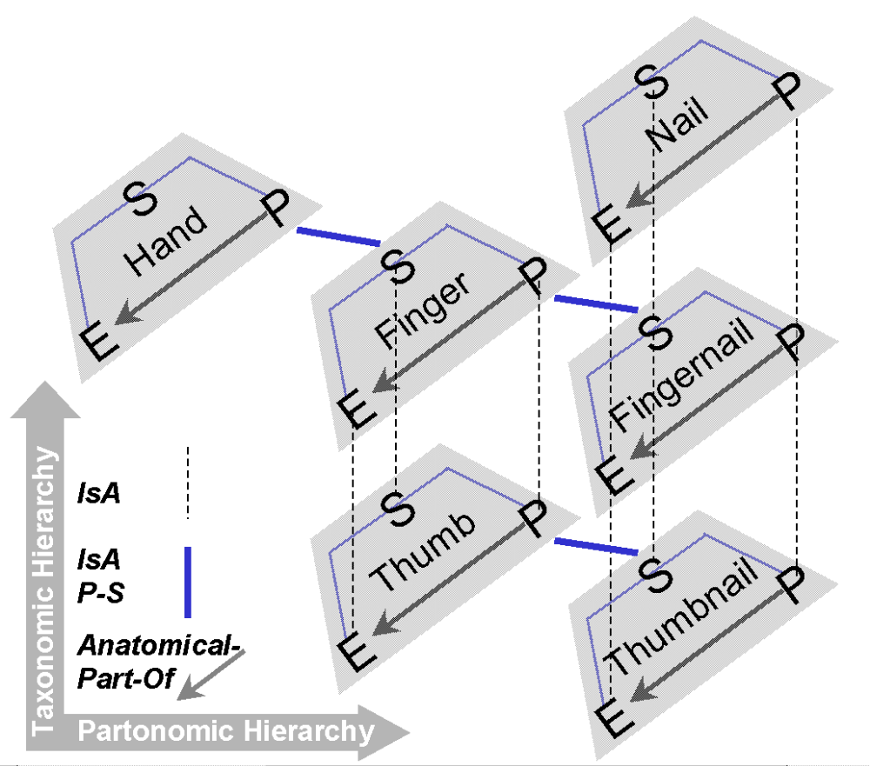
Double taxonomy: isa / part of
Schulz, S., Romacker, M., Faggioli, G., Hahn, U.:
Automatic Acquisition and Semi-Automatic Refinement of Medical Knowledge. In: Proc. 12th Workshop on K.A. for KBS. SRDG Publications, Banff (1999)

Slide 57
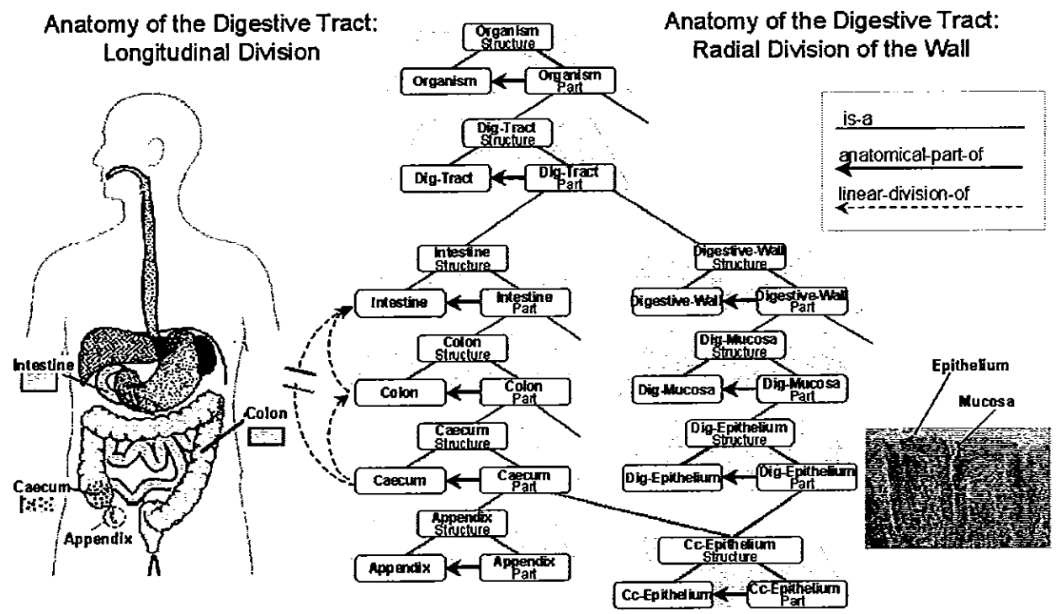
Hahn, U., Schulz, S., & Romacker, M. (1999). Partonomic reasoning as taxonomic reasoning in medicine.
In AAAI’99/IAAI’99 – Proceedings of the 16th National Conference on Artificial Intelligence &
11th Innovative Applications of Artificial Intelligence Conference., pages 271–276.
Orlando, Florida, July 18-22, 1999. Menlo Park, CA; Cambridge, MA: AAAI Press & MIT Press.

Slide 58
SEP-triplets in SNOMED CT
      Gastrointestinal tract structure (body structure)
      Intra-abdominal digestive structure (body structure)
      Structure of intestine and/or mesentery (body structure)
      Structure of organ within abdominopelvic cavity (body structure)
    Intestinal structure (body structure)
        Digestive organ structure (body structure)
          Body organ structure (body structure)
        Organ part (body structure)
      Digestive organ part (body structure)
      Lower gastrointestinal tract structure (body structure)
    Lower gastrointestinal tract part (body structure)
  Structure of large intestine (body structure)
Large intestine part (body structure)
Read in this direction !

Slide 59
‘A realism-based ontology’
‘An ontology built out of terms
which are intended to refer exclusively to universals,
and corresponds to that part of the content of a
scientific theory that is captured by its constituent
general terms and their interrelations’
≠ ‘be about’
Smith B, Kusnierczyk W, Schober D, Ceusters W.
Towards a Reference Terminology for Ontology Research and Development in the Biomedical Domain.
Proceedings of KR-MED 2006, Biomedical Ontology in Action,
November 8, 2006, Baltimore MD, USA.
http://ontology.buffalo.edu/bfo/Terminology_for_Ontologies.pdf

Slide 60
‘Term’
General term → generic entities
Specific term → specific/particular/individual entities
Application: Snomed CT
Problem?

Slide 61
Specific or generic terms?
Covid-19 is just one disease amongst so many.
John has Covid-19.
John’s Covid-19 evolves much worse than Mary’s Covid-19.

Slide 62
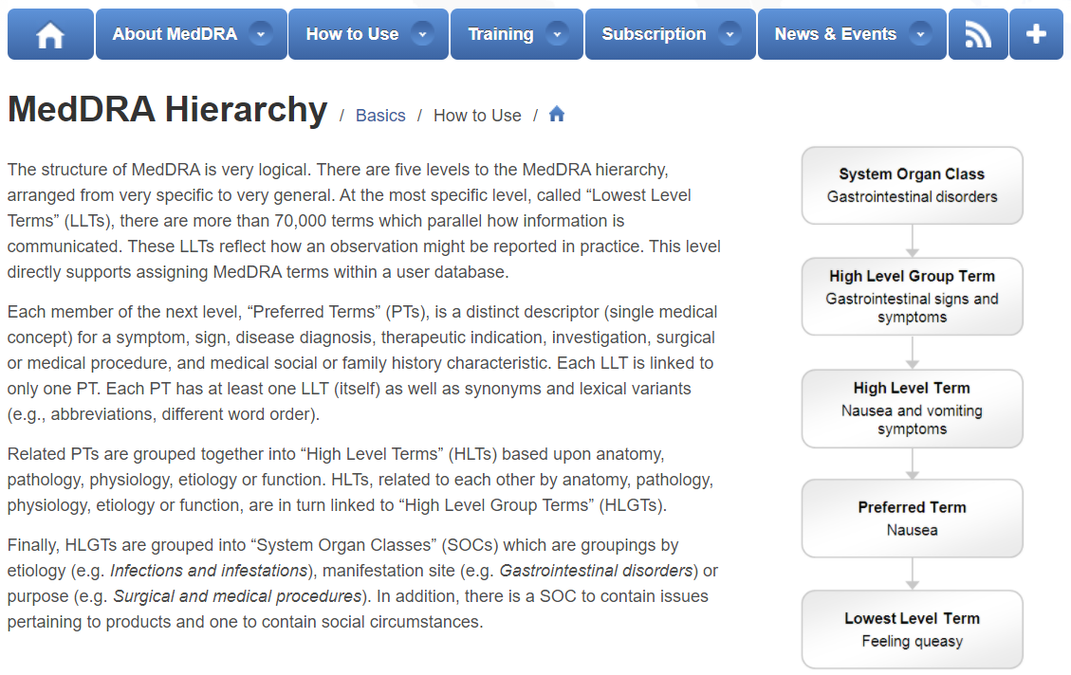
One of the most ridiculous systems ever built.
https://www.meddra.org/
The structure of MedDRA is very logical. There are five levels to the MedDRA hierarchy, arranged from very specific to very general. At the most specific level, called “Lowest Level Terms” (LLTs), there are more than 80,000 terms which parallel how information is communicated. These LLTs reflect how an observation might be reported in practice. This level directly supports assigning MedDRA terms within a user database.
Each member of the next level, “Preferred Terms” (PTs), is a distinct descriptor (single medical concept) for a symptom, sign, disease diagnosis, therapeutic indication, investigation, surgical or medical procedure, and medical social or family history characteristic. Each LLT is linked to only one PT. Each PT has at least one LLT (itself) as well as synonyms and lexical variants (e.g., abbreviations, different word order).
Related PTs are grouped together into “High Level Terms” (HLTs) based upon anatomy, pathology, physiology, aetiology or function. HLTs, related to each other by anatomy, pathology, physiology, aetiology or function, are in turn linked to “High Level Group Terms” (HLGTs).
Finally, HLGTs are grouped into “System Organ Classes” (SOCs) which are groupings by aetiology (e.g. Infections and infestations), manifestation site (e.g. Gastrointestinal disorders) or purpose (e.g. Surgical and medical procedures). In addition, there is a SOC to contain issues pertaining to products and one to contain social circumstances.

Slide 63
Adequate taxonomy design and classification
Taxonomy design:
Identify examples of particulars (‘individuals’, ‘things’, ‘entities’, …) you want to classify;
Identify the various characteristics that are possessed by (all or some of) these individual entities;
Identify groups (classes) on the basis of combinations of characteristics that co-occur;
Organize the groups hierarchically (‘parent-child’) so that characteristics that apply to a ‘parent’ (‘grandparent’,…) group apply to ALL groups beneath it;
Name the groups with terms that have face value.
Classification:
Assign individual entities to the groups that correspond with the combination of characteristics they exhibit.

Slide 64
Formal Concept Analysis (FCA)
Goal of FCA: build lattice from data tables that represent binary relations between objects and attributes, thus tabulating pairs of the form ‘object g has attribute m’.
A formal concept is defined to be a pair (A, B), where
  A is a set of objects (called the extent) and
  B is a set of attributes (the intent)
such that
  the extent A consists of all objects that share the attributes in B, and dually
  the intent B consists of all attributes shared by the objects in A.
https://en.wikipedia.org/wiki/Formal_concept_analysis

Slide 65
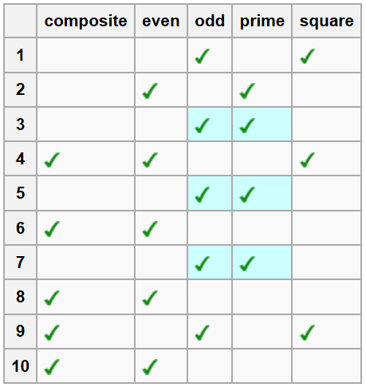
Easy example: FCA on the numbers 1 … 10
attributes
objects
https://en.wikipedia.org/wiki/Formal_concept_analysis

Slide 66
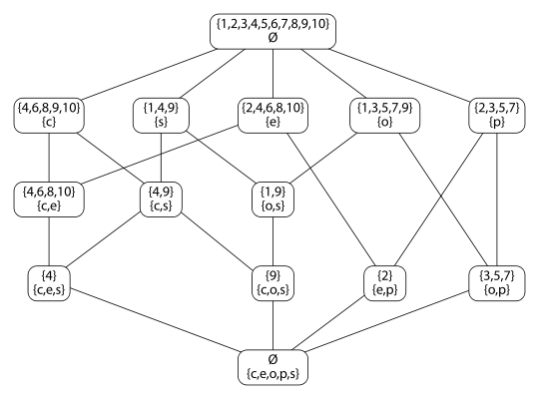
FCA lattice on the numbers 1 … 10
Graph formation principle:
  Each node contains 2 sets: a set O of objects and a set A of attributes such that all elements of O have all elements of A as attributes.
  The edges denote the ‘has subset’ relation.
https://en.wikipedia.org/wiki/Formal_concept_analysis

Slide 67
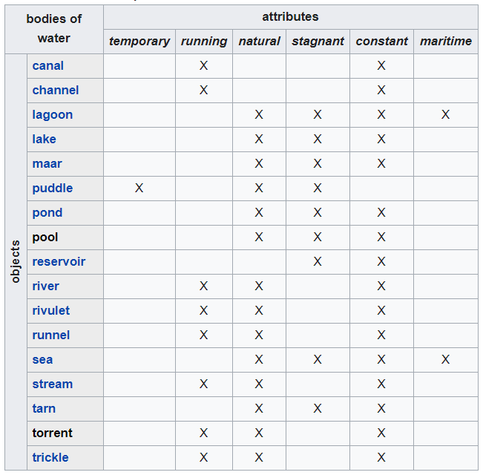
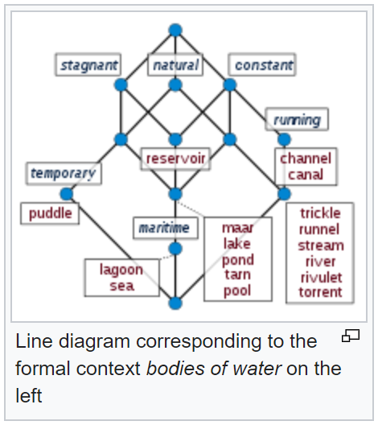
FCA on bodies of water
https://en.wikipedia.org/wiki/Formal_concept_analysis

Slide 68
FCA for calculating valid implications
Whenever a number out of 1 to 10 is odd, it is not even, and vice versa
https://en.wikipedia.org/wiki/Formal_concept_analysis

Slide 69
FCA for calculating valid implications
Whenever a number out of 1 to 10 is composite and odd, it is square.
https://en.wikipedia.org/wiki/Formal_concept_analysis

Slide 70
FCA for calculating valid implications
Whenever a number out of 1 to 10 is composite and odd, it is square.
This is not statistics! Compare with PCA, factor analysis, clustering, …
https://en.wikipedia.org/wiki/Formal_concept_analysis

Slide 71
What you should NEVER FORGET !!! (2)
(major take home message)
Crucial distinctions made in Ontological Realism
‘ontology’ ←→ ‘ontologies’
reality ←→ representation

Slide 72
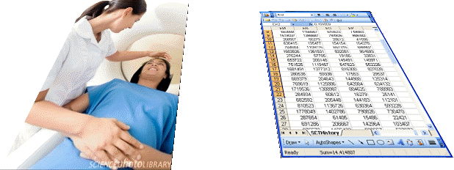

Realism-based Ontology (RBO)
Referents
  are (meta-) physically the way they are,
  relate to each other in an objective way,
  follow ‘laws of nature’.
Window on reality
  restricted by:
  what is physically and technically observable,
  fit between what is measured and what we think is measured,
  fit between established knowledge and ‘laws of nature’.
References
  follow, ideally, the syntactic-semantic conventions of some representation language,
  are restricted by the expressivity of that language,
  reference collections need to come, for correct interpretation, with documentation outside the representation.

Slide 73
What you should NEVER FORGET !!! (3)
(major take home message)
Crucial distinctions made in Ontological Realism
ontology ←→ ontologies
reality ←→ representation
particulars ←→ types

Slide 74
Remember: an ontology is …
‘a representational artifact, comprising a taxonomy as proper part, whose representational units are intended to designate some combination of universals, defined classes, and certain relations between them’
Smith B, Kusnierczyk W, Schober D, Ceusters W.
Towards a Reference Terminology for Ontology Research and Development in the Biomedical Domain.
Proceedings of KR-MED 2006, Biomedical Ontology in Action,
November 8, 2006, Baltimore MD, USA.
http://ontology.buffalo.edu/bfo/Terminology_for_Ontologies.pdf

Slide 75
‘Types’
‘concepts’
‘kinds’
‘universals’
‘categories’
‘classes’
‘prototypes’
…
In realism-based ontology:
  Universals: human being
  Defined classes: human being in Buffalo

Slide 76
Types, universals, defined classes
Barry’s My
terminology terminology
Type
Type
Universal
Universal
Defined class
Defined class

Slide 77
Commitment to universals
Nominalism:
  there are no generic entities in reality: there is no personhood, there are only individual persons.
Conceptualism:
  generalizations are in our ‘minds’. Personhood is a concept construed in our ‘mind’ that allows us to reason about persons without any particular person in mind.
Realism:
  generic entities do exist and are called ‘universals’. Each particular person is an instance of the universal we call ‘person’.

Slide 78
Conceptualism versus Ontological Realism (1)
concept
universal
term
referent
representational
unit
particular
Conceptualism
Ontological Realism

Slide 79
Conceptualism versus Ontological Realism (2)
First order reality
concept
universal
term
referent
representational
unit
particular
Conceptualism
Ontological Realism

Slide 80
Types versus particulars
Universals
Particulars
counterparts in reality of (some of)
the general terms used in the formulation of scientific theories
concrete individual entities
(entities that exist in space and time and that exist only once)
Smith B, Ceusters W. Ontological Realism as a Methodology for Coordinated Evolution of Scientific Ontologies. Applied Ontology, 2010;5(3-4):139-188.

Slide 81
Types versus particulars
for every universal there is or has been at least one instance
some type
some time
Instance-of at
entities on either site cannot ‘cross’ this boundary
every particular is an instance of at least one universal
some particular

Slide 82

BFO2020-FOL axiom [qkp-1]
(cl:comment "universals are not particulars [qkp-1]"
(not (exists (x)
(and (universal x)
(particular x)))))
Legend:
logical connector
quantifier
relation
variable; denoting a particular or a universal
universal

Slide 83
BFO2020-FOL axiom [lqn-1]
(cl:comment "Relata of instance-of are particular, universal, temporal-region. [lqn-1]"
(forall (i u t)
(if (instance-of i u t)
(and (particular i)
(universal u)
(instance-of t temporal-region t)))))
Legend:
logical connector
quantifier
relation
variable; denoting a particular or a universal
universal

Slide 84
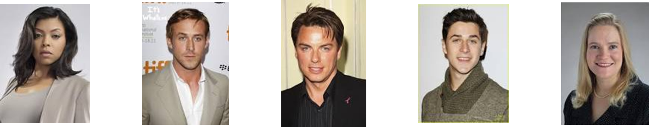
Types versus particulars (1)
Human being
instance of at t
particulars

Slide 85
Types versus particulars (2)
Photograph
instance of at t
particulars

Slide 86

Instances are the objects of classification …
isa
Organism
isa
Vertebrate
isa
Mammal
Human being
instance of at t
particulars

Slide 87
Instances are the objects of classification …
isa
Organism
isa
Vertebrate
isa
Mammal
Human being
instance of at t
particulars

Slide 88
A is_a B in BFO
A is_a B =def.
  A and B are names of universals (natural kinds, types) in reality or of defined classes
  for all times t, all instances of A at t are as a matter of science also instances of B at t

Slide 89
Formal BFO definition for is_a
The is_a relation is the subtype or subuniversal relation between universals or types.
In the BFO-book (Arp et al 2015):
  (1) C is_a C1 =def.:
    C and C1 are continuant universals, and
    for all c, t, if c instance_of C at t then c instance_of C1 at t
  (2) P is_a P1 =def.:
    P and P1 are occurrent universals, and
    for all p, if p instance_of P then p instance_of P1
In BFO2020-FOL: (1) also applied to occurrents !

Slide 90
‘Isa’ – taxonomy á la BFO2020-FOL
(universal organism)
(universal vertebrate)
(universal mammal)
(universal human-being)
(forall (t x)
(if (instance-of x vertebrate t)
(instance-of x organism t)))
(forall (t x)
(if (instance-of x mammal t)
(instance-of x vertebrate t)))
(forall (t x)
(if (instance-of x human-being t)
(instance-of x mammal t)))

Slide 91
Compare with RDFS / OWL
AXIOM SCHEMA: class description rdfs:subClassOf class description
The rdfs:subClassOf construct is defined as part of RDF Schema [RDF Vocabulary]. Its meaning in OWL is exactly the same: if the class description C1 is defined as a subclass of class description C2, then the set of individuals in the class extension of C1 should be a subset of the set of individuals in the class extension of C2.
Differences with BFO:
  subClass is primitive, being a subset is a consequence
  You just have to declare it → how do you want the domain to be, not how the domain is!
  No time indexing.

Slide 92
Subtype relation / subset relation
BFO OWL
BFO subtyping builds on mereology:
  ‘mereology is simply an attempt to lay down the general principles underlying the relationships between an entity and its constituent parts, whatever the nature of the entity’.
OWL’s subclassing builds on set theory:
  ‘set theory is an attempt to lay down the principles underlying the relationships between a set and its members’.
‘Unlike set theory, mereology is not committed to the existence of abstracta: the whole can be as concrete as the parts. But mereology carries no nominalistic commitment to concreta either: the parts can be as abstract as the whole’.
Varzi, Achille, "Mereology", The Stanford Encyclopedia of Philosophy (Spring 2019 Edition), Edward N. Zalta (ed.)

Slide 93
Early goals of Biomedical Ontology in
Healthcare Information Technology (HIT)
supporting the creation and use of adequate biomedical terminology.
supporting the creation of adequate coding and classification systems.

Slide 94
Goals of Biomedical Ontology in
Healthcare Information Technology (HIT)
supporting the creation and use of adequate biomedical terminology.
supporting the creation of adequate coding and classification systems.
solving the semantic interoperability problem for heterogeneous biomedical information systems.
improving biomedical decision support applications.

Slide 95
Additional Goals of Realism-based Biomedical Ontology in HIT
supporting the identification of what sorts of biomedical entities exist, how they relate to each other and how they are best represented.
supporting the creation and use of adequate biomedical terminology.
supporting the creation of adequate coding and classification systems.
solving the semantic interoperability problem for heterogeneous biomedical information systems.
improving biomedical decision support applications.
assisting in the education of healthcare workers.
…

Slide 96
What you should NEVER FORGET !!! (4)
(major take home message)
Crucial distinctions made in Ontological Realism
ontology ←→ ontologies
reality ←→ representation
particulars ←→ types
continuants ←→ occurrents

Slide 97
Continuants ←→ Occurrents
 | Continuant | Occurrent
Entities that at any time they exist,
exist
in total
Entities that at any time they exist,
exist only
partially
Smith B, Ceusters W. Ontological Realism as a Methodology for Coordinated Evolution of Scientific Ontologies. Applied Ontology, 2010;5(3-4):139-188.

Slide 98
An ontological square
 | Continuant | Occurrent
Types | Tooth | Teeth grinding
Particulars | My left maxillary first molar | My teeth grinding

Slide 99
An ontological square
 | Continuant | Occurrent
Types | Tooth | Teeth grinding
Particulars | My left maxillary first molar | My teeth grinding
Instance
of at t
Instance
of at t

Slide 100
Continuant vs. occurrent (1)
(cl:comment "continuant, occurrent are mutually disjoint [wrf-1]"
(not (exists (x t)
(and (instance-of x continuant t)
(instance-of x occurrent t)))))
(cl:comment "If something is a continuant at any time then as long as it exists it is a continuant. [ghs-1]"
(forall (x)
(if (exists (t) (instance-of x continuant t))
(forall (t)
(if (exists-at x t)
(instance-of x continuant t))))))

Slide 101
Continuant vs. occurrent (2)
(cl:comment "No occurrent changes type during its existence [ayr-1]"
(forall (o)
(if (exists (t) (instance-of o occurrent t))
(forall (u)
(if (exists (t) (instance-of o u t))
(forall (t)
(iff (instance-of o occurrent t)
(instance-of o u t))))))))
!!! Certain continuants can become of a different subtype during their existence, but occurrents never !!!

Slide 102
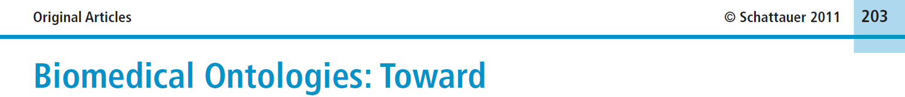


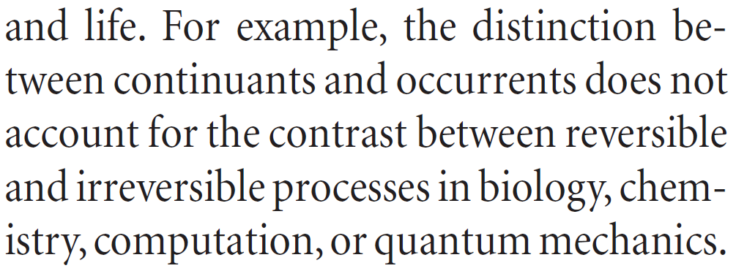
Simple, yet seemingly hard to grasp …
Methods Inf Med 2011; 50: 203-216
Page 205

Slide 103
How could the distinction account for it ?
Continuant | Occurrent
‘the distinction between
continuants and occurrents does not account for the contrast between reversible
and irreversible processes’
Irreversible Process
Reversible Process
Maojo V, Crespo J, Garcia-Remesal M, de la Iglesia D, Pérez-Rey D, Kulikowski C.
Biomedical Ontologies: Toward scientific debate.
Methods Inf Med 2011; 50 (3):203-216.

Slide 104
The importance of temporal indexing
benign
tumor
malignant
tumor
stomach
instanceOf at t₂
instanceOf at t₁
instanceOf at t₂
instanceOf at t₁
partOf at t₁
this-4
this-1’s stomach
partOf at t₂

Slide 105
The importance of temporal indexing
benign
tumor
malignant
tumor
stomach
instanceOf at t₂
instanceOf at t₁
instanceOf at t₂
instanceOf at t₁
this-4
partOf at t₁
this-1’s stomach
this-5
partOf at t₂

Slide 106


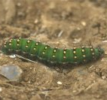

Continuants preserve identity while changing
human
being
me
me
t
Instance-of
in 1960
child
Instance-of
since 1980
adult
living
creature
animal
caterpillar
butterfly

